Slide 1
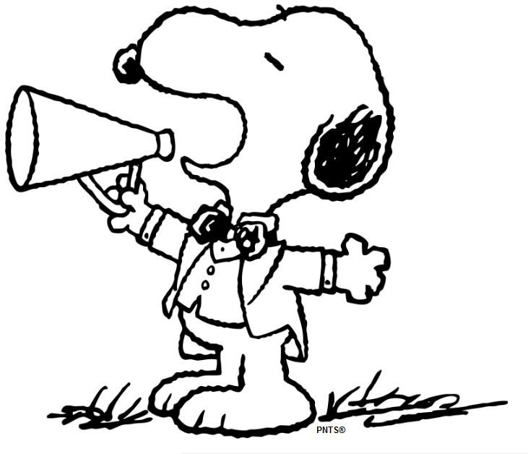
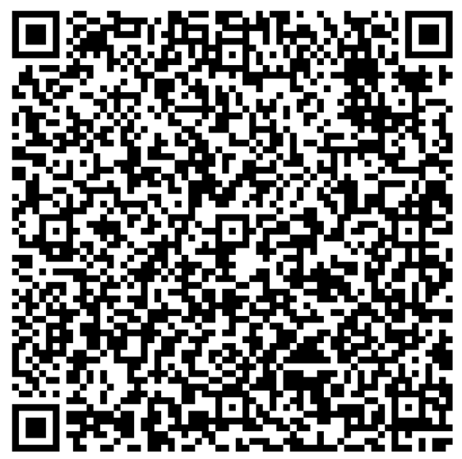
MRS.PEACOCK’S
WEEK OF: FEBRUARY 12-16, 2024
WE ARE LEARNING
Coming up @ NSE
Weekly Skills
WORDS TO KNOW
ELA: Poetry
PHONICS: OI, OY
MATH: Subtracting two 3- digit numbers
LANGUAGE: OPINION WRITING
Social Studies: Famous Americans
2/19- SCHOOL HOLIDAY (NO SCHOOL)
2/20- STUDENT HOLIDAY (NO SCHOOL)
2/29- PARENT LITERACY NIGHT @ NSE
PHONICS Skill OF THE WEEK
VOCABULARY
Spelling Words – OI, OY
**vocab test will be 2/23**
1.) setting- where a story takes place
2.) repeat- to say it again
3.) poet- a person who writes a poem
4.) poem- a piece of writing where words are in short lines and usually rhyme
5.) rhyme- words that have the same ending sound
destroy
oil
joint
enjoy
joy
coin
laugh
please
noisy
voice
annoy
soy
boil
point
cowboy
join
toy
soil
eye
head
IMPORTANT DATES
YEARBOOKS ARE ON SALE
THROUGH FEB. 29TH!
SPRING MUSIC PROGRAM
Our music program is April 4th! Sign & return your slip if you want your child to participate! ☺
Homework and Tests:
Spelling and Fact Tests Friday
Reading, Math, and Fact homework each night.

